Slide 1
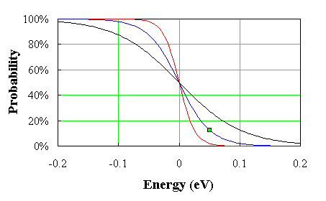
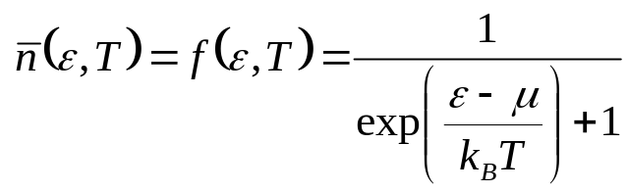
Lecture 24. Degenerate Fermi Gas (Ch. 7)
We will consider the gas of fermions in the degenerate regime, where the density n exceeds by far the quantum density n_{Q}, or, in terms of energies, where the Fermi energy exceeds by far the temperature. We have seen that for such a gas μ is positive, and we’ll confine our attention to the limit in which μ is close to its T=0 value, the Fermi energy E_{F}.
~ k_{B}T
μ / E_{F}
1
occupancy
1
k_{B}T/E_{F}
T =0
(with respect to E_{F})
The most important degenerate Fermi gas is the electron gas in metals and in white dwarf stars. Another case is the neutron star, whose density is so high that the neutron gas is degenerate.

Slide 2
Degenerate Fermi Gas in Metals
empty states
ε
We consider the mobile electrons in the conduction band which can participate in the charge transport. The energy is measured from the bottom of the conduction band. When the metal atoms are brought together, their outer electrons break away and can move freely through the solid. In good metals with the concentration ~ 1 electron/ion, the density of electrons in the conduction band n ~ 1 electron per (0.2 nm)³ ~ 10²⁹ electrons/m³ .
E_{F}
conduction
band
0
valence
band
electron states
in an isolated
atom
electron states
in metal
The electrons are prevented from escaping from the metal by the net Coulomb attraction to the positive ions; the energy required for an electron to escape (the work function) is typically a few eV. The model assumes that the electrons for an ideal Fermi gas confined within impenetrable walls.
Why can we treat this dense gas as ideal? Indeed, the Coulomb interactions between electrons at this density must be extremely strong, and in a a solid, the electrons move in the strong electric fields of the positive ions. The first objection is addressed by the Landau’s Fermi liquid theory. The answer to the second objection is that while the field of ions alters the density of states and the effective mass of the electrons, it does not otherwise affect the validity of the ideal gas approximation. Thus, in the case of “simple” metals, it is safe to consider the mobile charge carriers as electrons with the mass slightly renormalized by interactions. There are, however, examples that the interactions lead to the mass enhancement by a factor of 100-1000 (“heavy fermions”).

Slide 3
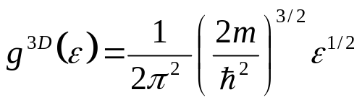
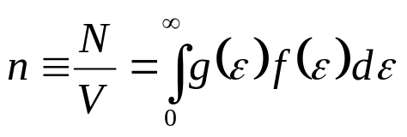
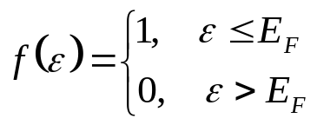
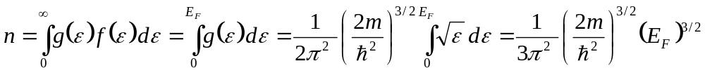
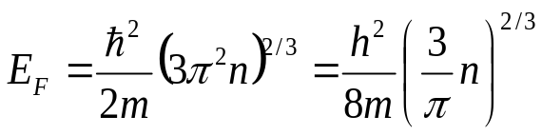
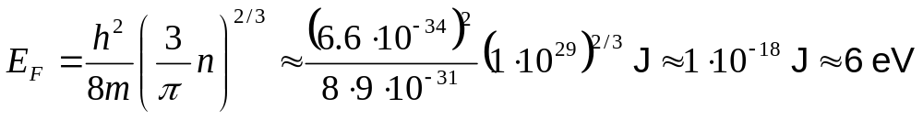

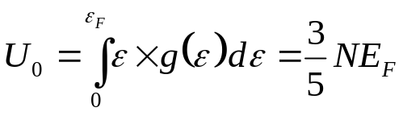

The Fermi Energy
The density of states per unit volume for a 3D free electron gas (m is the electron mass):
The number of electron per unit volume:
At T = 0, all the states up to ε = E_{F} are filled, at ε > E_{F} – empty:
the Fermi energy (μ of an ideal Fermi gas at T=0)
ε
T>0
ε = E_{F}
- at room temperature, this Fermi gas is strongly degenerate (E_{F} >> k_{B}T).
The total energy of all electrons in the conduction band (per unit volume):
- a very appreciable zero-point energy!

Slide 4

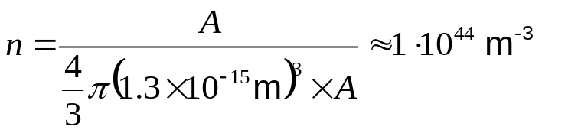

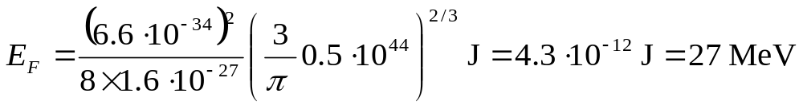

The Fermi Gas of Nucleons in a Nucleus
Let’s apply these results to the system of nucleons in a large nucleus (both protons and neutrons are fermions). In heavy elements, the number of nucleons in the nucleus is large and statistical treatment is a reasonable approximation. We need to estimate the density of protons/neutrons in the nucleus. The radius of the nucleus that contains A nucleons:
Thus, the density of nucleons is:
For simplicity, we assume that the # of protons = the # of neutrons, hence their density is
The Fermi energy
E_{F} >>> k_{B}T – the system is strongly degenerate. The nucleons are very “cold” – they are all in their ground state!
The average kinetic energy in a degenerate Fermi gas = 0.6 of the Fermi energy
- the nucleons are non-relativistic

Slide 5
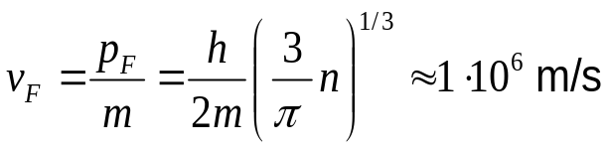
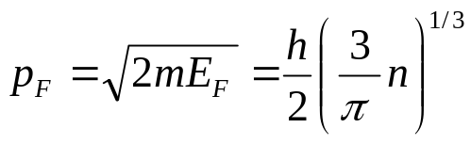
The Fermi Momentum
The electrons at the Fermi level are moving at a very high velocity, the Fermi velocity:
This velocity is of the same order of magnitude as the orbital velocity of the outer electrons in an atom, and ~10 times the mean thermal velocity that a non-degenerate electron gas would have at room temperature. Still, since v_{F}<<c, we can treat the mobile electrons as non-relativistic particles.
The corresponding momentum:
the Fermi momentum
Naturally, the entropy of Fermi gas is zero at T=0 – we are dealing with a single state that can undergo no further ordering process.
What happens as we raise T, but keep k_{B}T<<E_{F} so that μ ≈ E_{F}?
ε
ε = E_{F}
~ k_{B}T
Empty states are available only above (or within ~ k_{B}T ) of the Fermi energy, thus a very small fraction of electrons can be accelerated by an electric field and participate in the current flow.
occupancy
T =0
The electrons with energies ε < E_{F} - (few) k_{B}T cannot interact with anything unless this excitation is capable of
(with respect to E_{F})
raising them all the way to the Fermi energy.

Slide 6
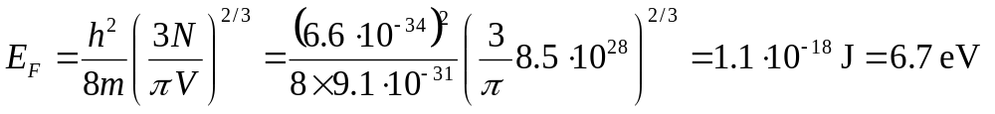
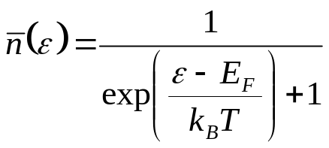
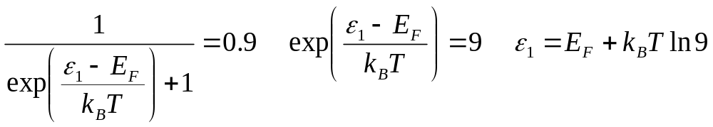
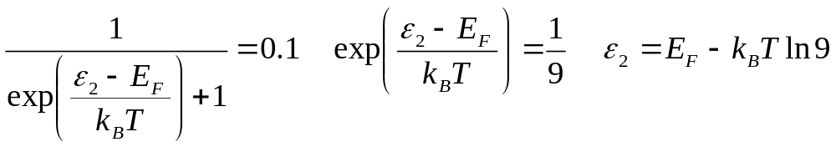

Problem (Final 2005)
When the copper atoms form a crystal lattice with the density of atoms of 8.5·10²⁸ m⁻³, each atom donates 1 electron in the conduction band.
(a) Assuming that the effective mass of the conduction electrons is the same as the free electron mass, calculate the Fermi energy. Express your answer in eV.
The electrons participate in the current flow if their energies correspond to the occupancy n(ε) that is not too close to 1 (no empty states available for the accelerated electrons) and not too small (no electrons to accelerate). At T=300K, calculate the energy interval that is occupied by the electrons that participate in the current flow, assuming that for these electrons the occupancy varies between 0.1 and 0.9.

Slide 7
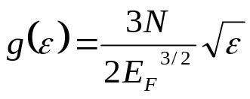
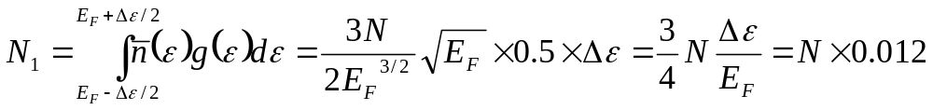
Problem (Final 2005, cont.)
Using the assumptions of (b), calculate the ratio N₁/N₀ where N₁ is the number of “current-carrying” electrons, N₀ is the total number of electrons in the conduction band. Assume that within the range where the occupancy varies between 0.1 and 0.9, the occupancy varies linearly with energy (see the Figure), and the density of states is almost energy-independent. The density of states for the three-dimensional Fermi gas:
(c)
occupancy
ε - E_{F}
Thus, at T=300K, the ratio of the “current-carrying” electrons to all electrons in the conduction is 0.012 or 1.2 %.

Slide 8
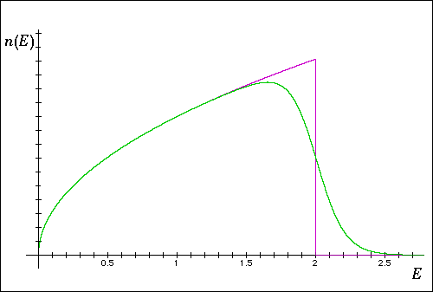
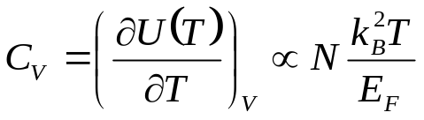
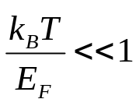
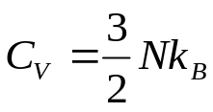
The Heat Capacity of a Cold Fermi Gas
One of the greatest successes of the free electron model and FD statistics is the explanation of the T dependence of the heat capacity of a metal.
So far, we have been dealing with the Fermi gas at T = 0. To calculate the heat capacity, we need to know how the internal energy of the Fermi gas, U(T), depends on the temperature. Firstly, let’s predict the result qualitatively.
By heating a Fermi gas, we populate some states above the Fermi energy E_{F} and deplete some states below E_{F}. This modification is significant within a narrow energy range ~ k_{B}T around E_{F} (we assume that the system is cold - strong degeneracy).
k_{B}T
The fraction of electrons that we “transfer” to higher energies ~ k_{B}T/E_{F}, the energy increase for these electrons ~ k_{B}T. Thus, the increase of the internal energy with temperature is proportional to N×(k_{B}T/E_{F}) ×(k_{B}T) ~ N (k_{B}T)² /E_{F}.
is much smaller (by ) than
for an ideal gas
The Fermi gas heat capacity is much smaller than that of a classical ideal gas with the same energy and pressure. This is because only a small fraction k_{B}T/E_{F} of the electrons are excited out of the ground state. As required by the Third Law, the electronic heat capacity in metals goes to 0 at T → 0.

Slide 9
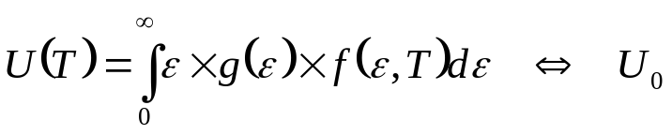
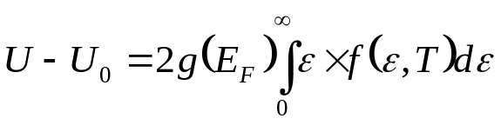
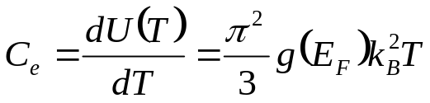
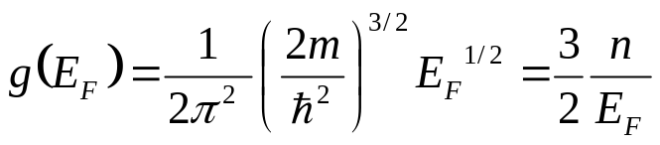
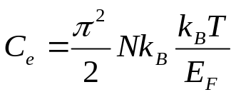
The Heat Capacity of a Cold Fermi Gas (cont.)
A bit more quantitative approach: the difference in energy between the gas at a finite temperature and the gas in the ground state (T = 0):
When we consider the energies very close to µ ~ E_{F}, we will ignore the variation in the density of states, and evaluate the integral with g(ε) ≈ g(E_{F}). The density of states at the Fermi level is one of the most important properties of a metal, since it determines the number of states available to the electrons which can change their state under “weak” excitations.
occupancy
ε with respect to E_{F}
So long as k_{B}T << E_{F}, the distribution function f(ε) is symmetric about E_{F}. By heating up a metal, we take a group of electrons at the energy - ε (with respect to E_{F}), and “lift them up” to ε. The number of electrons in this group g(E_{F})f(ε)dε and each electron has increased its energy by 2 ε:
- the lower limit is 0, we integrate from E_{F}
- much less than the “equipartition” C. The small heat capacity is a direct consequence of the Pauli principle: most of the electrons cannot change their energy.

Slide 10

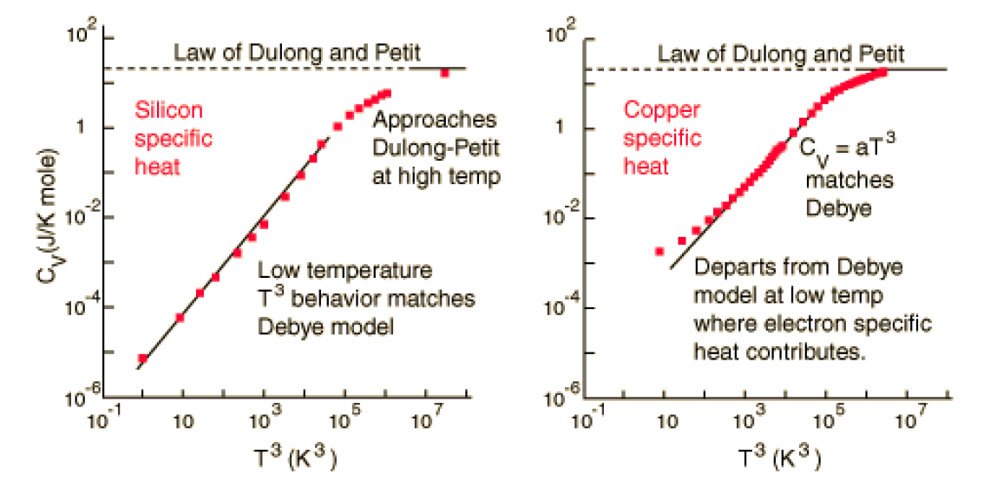
Experimental Results
At low temperatures, the heat capacity of metals can be represented as the sum of two terms:
due to electrons
due to phonons
At T < 10 K, this linear (electronic) term dominates in the total heat capacity of metals: the other term due to lattice vibrations “dies out” at T → 0 faster, as T ³.

Slide 11
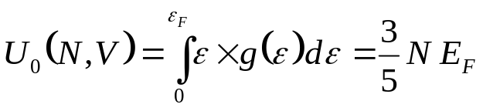
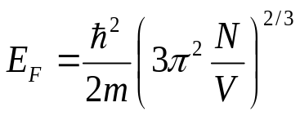
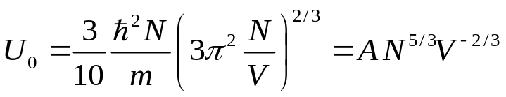
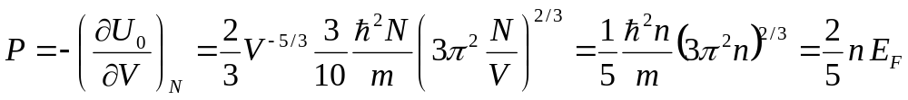
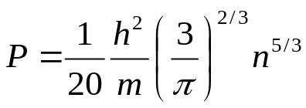
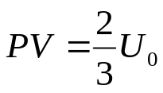
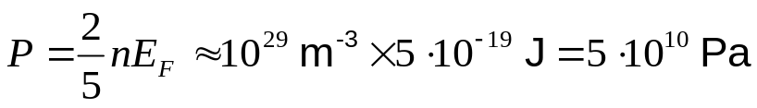
Pressure of the Fermi Gas
The internal energy and pressure of an ideal gas goes to 0 as T→0. This is not the case for a degenerate Fermi gas !
On the other hand,
and
At T=0, there is no distinction between the free energy F and the internal energy U₀:
- it looks just as for an ideal gas. This is a direct consequence of the quadratic relation between energy and momentum.
or
However, this is a non-zero pressure at T = 0, which does not depend on T at T << E_{F}.
Let’s estimate this pressure for a typical metal:
In metals, this enormous pressure is counteracted by the Coulomb attraction of the electrons to the positive ions.
When an electron is confined in a very small space, it "flies about its tiny cell at high speed, kicking with great force against adjacent electrons in their cells. This degenerate motion ... cannot be stopped by cooling the matter. Nothing can stop it; it is forced on the electron by the laws of quantum mechanics, even when the matter is at absolute zero temperature" (Thorne 1994).

Slide 12
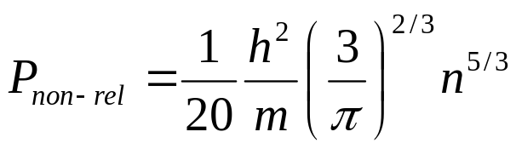

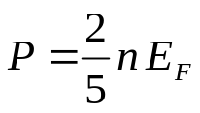
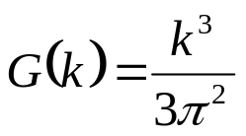
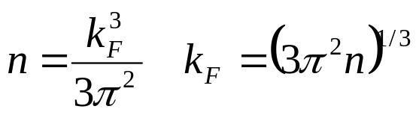


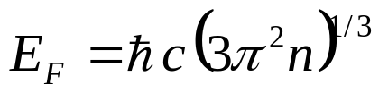
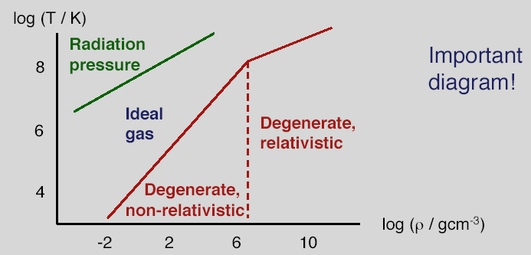
Fermi Pressure in the Universe
- scales with the density as n^{5/3} provided that the electrons remain non-relativistic (speeds v << c). In a white dwarf or a neutron star, this approximation breaks down.
For the relativistic degenerate matter, the equation of state is “softer”
The number of electrons per unit volume with k<k_{F}:
At T=0, all the states up to k_{F} are occupied:
In the ultra-relativistic case
The relativistic and non-relativistic expressions for electron degeneracy pressure are equal at about that n_{e} =10³⁶ m⁻³, about that of the core of a 0.3 M white dwarf.
As long as the star is not too massive, the Fermi pressure prevents it from collapsing under gravity and becoming a black hole.

Slide 13
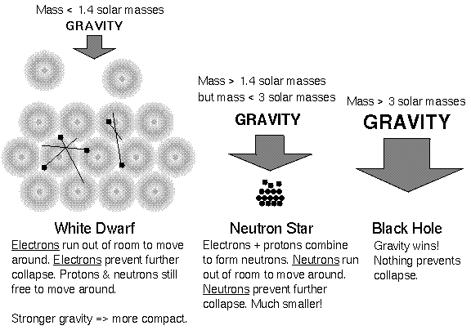
Star Evolution
How stars can support themselves against gravity:
gas and radiation pressure supports stars in which thermonuclear reactions occur
pressure of a degenerate electron gas at high densities supports the objects with no fusion: dead stars (white dwarfs) and the cores of giant planets (Jupiter, Saturn)
pressure of a degenerate neutron gas at high densities support neutron stars

Slide 14

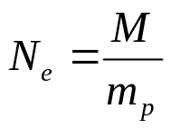
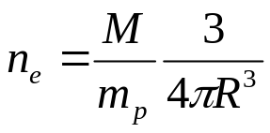
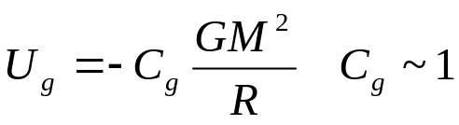
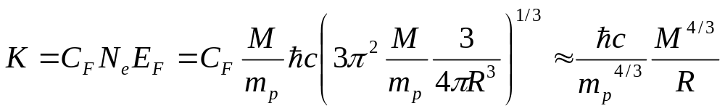
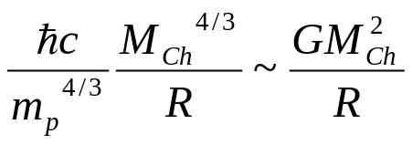
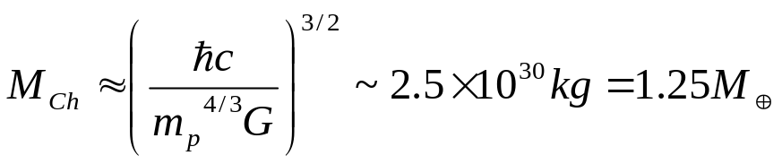
White dwarfs
By combining the ideas of relativity and quantum mechanics, Chandrasekhar made important contributions to our understanding of the star evolution.
Nobel 1983
The Fermi pressure of a degenerate electron gas prevents the gravitational collapse of the star if the star is not too massive (the white dwarf).
An estimate the upper limit of the white dwarf’s mass (the Chandrasekhar mass):
Total number of electrons in the star ~ the number of protons:
Total potential (gravitational) energy of the star:
proton mass
Kin. energy of the Fermi gas of electrons (relativistic case):
-U_{g}
energy
K
If M<M_{Ch}, the Fermi pressure is sufficient to prevent the collapse.
M_{Ch}
M
(more accurately – 1.4 M)

Slide 15

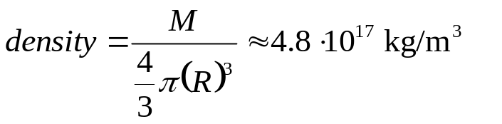
Neutron Stars [ M=(1.4-3)M ]
For a dead star more massive than 1.4 M_{Sun}, the electron degeneracy pressure cannot prevent the gravitational collapse. During the collapse an extra energy liberated is sufficient to drive a nuclear reaction:
If the mass is not too high (<3 M_{Sun}), the further contraction is stopped by the degeneracy pressure of neutrons (otherwise – black hole).
By knowing the parameters of neutron stars, we can explain why these stars are made of neutrons. A typical neutron star has a mass like the Sun (M_{Sun} = 2 × 10³³ g), but a much smaller radius R ~10 km. The average density is
about three times nuclear density. In terms of the concentration of neutrons, this corresponds to n = 3 × 10⁴⁴ m⁻³. Let the star be made, instead of neutrons, of protons and electrons, each with the concentration n ~ 3 × 10⁴⁴ m⁻³, the # of protons = the # of electrons (the star is electrically neutral). The mass difference between a proton and a neutron is greater than the mass of an electron:
so this configuration would seem to be energetically favored over the neutron configuration. However, let’s look at the Fermi energies of the protons and electrons in this hypothetical star. The proton E_{F} would be very nearly the same as that for the neutrons above (because the concentration would be the same and the mass is nearly the same). On the other hand, the electron E_{F} would be larger by the ratio M_{n}/m_{e} ~1838, so the electron E_{F} would be ~160,000 MeV, enough to make about 170 nucleons!

